Slide 1




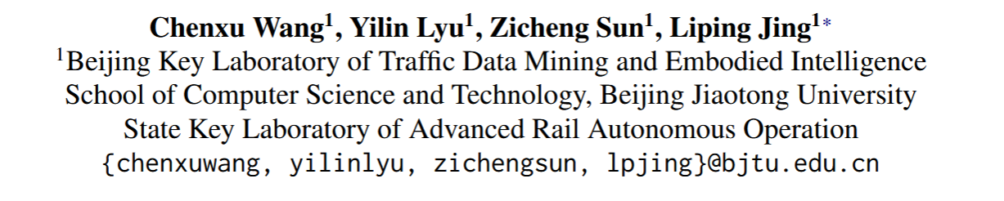





ATAI
Advanced Technique of Artificial Intelligence
ATAI
ChongqingUniversity _{AdvancedTechniqueof}
of Technology Artificial Intelligence
Chongqing University of
Technology
Chongqing University ^{ATAI}
_{of Technology} Advanced Techniqueof
Artificial Intelligence
Chongqing University of Technology
Chongqing University of Technology
Continual Gradient Low-Rank Projection Fine-Tuning for LLMs
https://github.com/Wcxwcxw/GORP
——ACL_2025
Reported by Jingbo Liu
1

Slide 2
ATAI
Advanced Technique of Artificial Intelligence
ATAI
ChongqingUniversity _{AdvancedTechniqueof}
of Technology Artificial Intelligence
Chongqing University of
Technology
Chongqing University ^{ATAI}
_{of Technology} Advanced Techniqueof
Artificial Intelligence
Chongqing University of Technology
Chongqing University of Technology
Motivation
While LoRA significantly reduces training complexity and storage, the low-rank matrices inherently constrain the parameter space and, consequently, the model’s expressiveness during optimization. This restriction to a low-rank subspace can lead to suboptimal performance compared to full fine-tuning, a gap that often widens in continual learning settings.
2) Furthermore, LoRA updates are intertwined with shared parameter updates, potentially causing collisions in the parameter spaces of different tasks . Gradient projection has emerged as a promising mitigation strategy .Existing methods that impose explicit constraints on LoRA’s low-rank can only approximate the ideal parameter space and fail to adapt dynamically to the changing gradient space of new tasks.

Slide 3
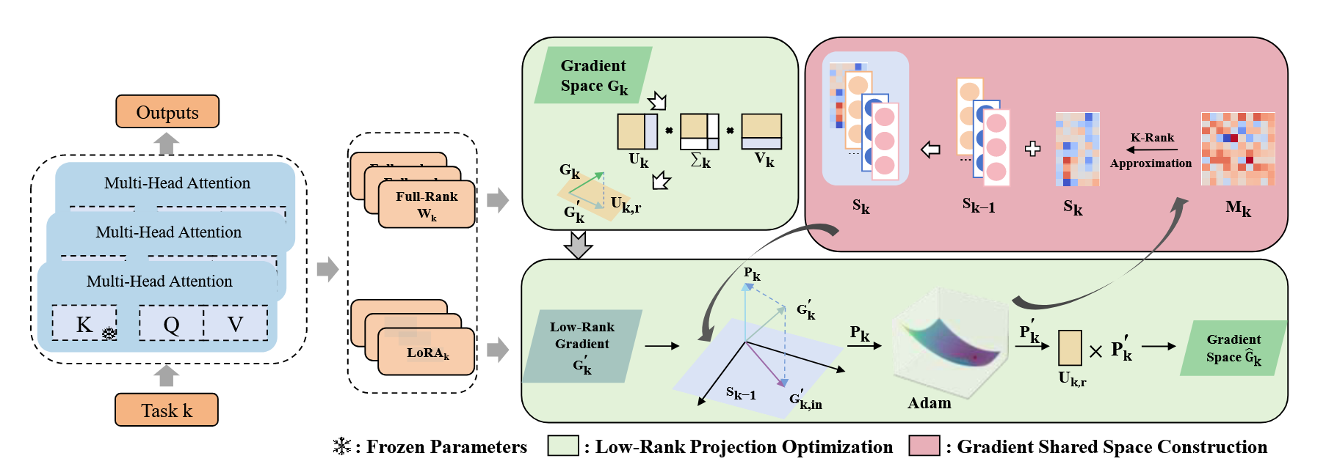
ATAI
ChongqingUniversity _{AdvancedTechniqueof}
of Technology Artificial Intelligence
Chongqing University of
Technology
ATAI
Advanced Technique of Artificial Intelligence
Chongqing University ^{ATAI}
_{of Technology} Advanced Techniqueof
Artificial Intelligence
Chongqing University of Technology
Chongqing University of Technology
Method

Slide 4



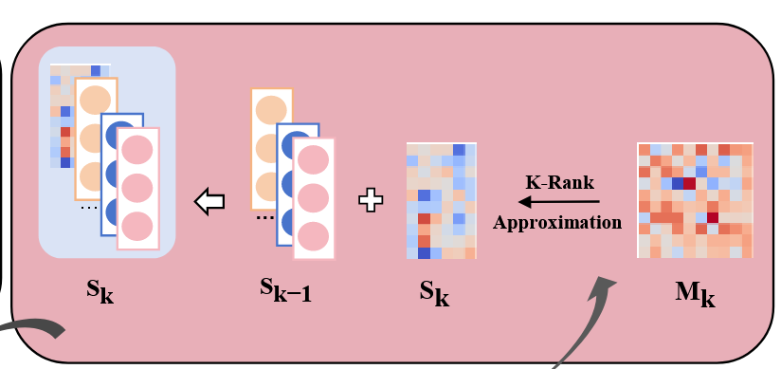



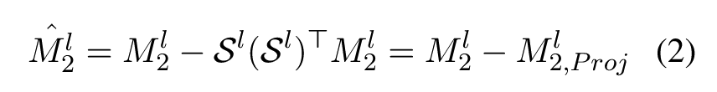



ATAI
Advanced Technique of Artificial Intelligence
ATAI
ChongqingUniversity _{AdvancedTechniqueof}
of Technology Artificial Intelligence
Chongqing University of
Technology
Chongqing University ^{ATAI}
_{of Technology} Advanced Techniqueof
Artificial Intelligence
Chongqing University of Technology
Chongqing University of Technology
Method

Slide 5
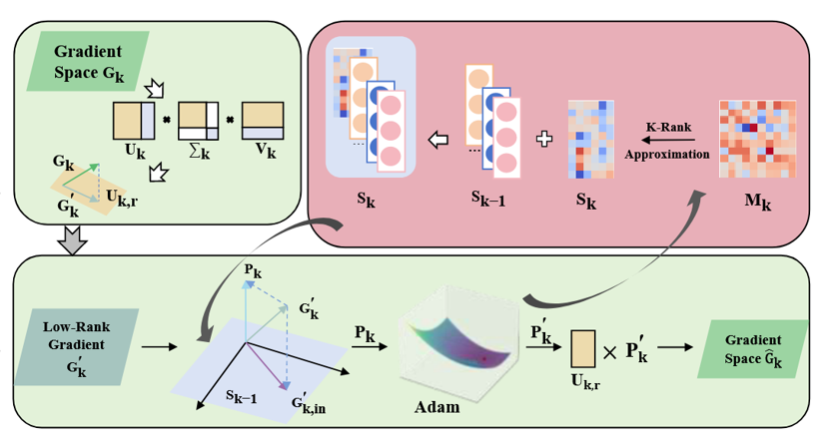


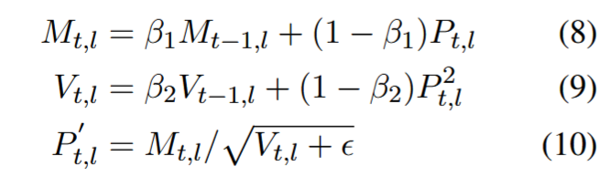
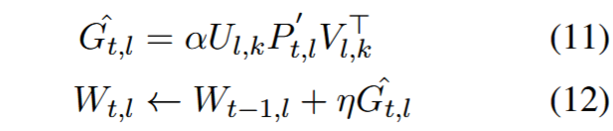
ATAI
Advanced Technique of Artificial Intelligence
ATAI
ChongqingUniversity _{AdvancedTechniqueof}
of Technology Artificial Intelligence
Chongqing University of
Technology
Chongqing University ^{ATAI}
_{of Technology} Advanced Techniqueof
Artificial Intelligence
Chongqing University of Technology
Chongqing University of Technology
Method

Slide 6
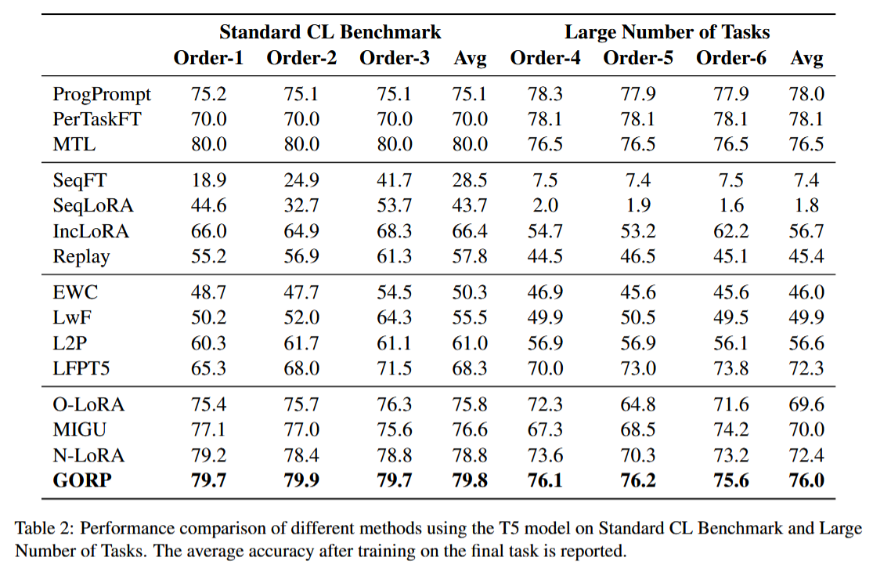
ATAI
Advanced Technique of Artificial Intelligence
ATAI
ChongqingUniversity _{AdvancedTechniqueof}
of Technology Artificial Intelligence
Chongqing University of
Technology
Chongqing University ^{ATAI}
_{of Technology} Advanced Techniqueof
Artificial Intelligence
Experiments
Chongqing University of Technology
Chongqing University of Technology

Slide 7
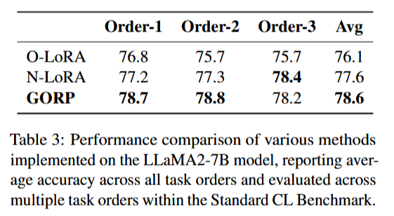
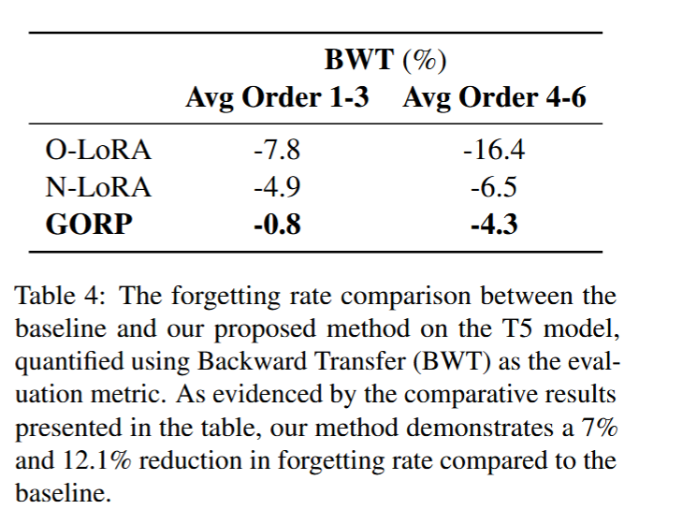
ATAI
Advanced Technique of Artificial Intelligence
ATAI
ChongqingUniversity _{AdvancedTechniqueof}
of Technology Artificial Intelligence
Chongqing University of
Technology
Chongqing University ^{ATAI}
_{of Technology} Advanced Techniqueof
Artificial Intelligence
Experiments
Chongqing University of Technology
Chongqing University of Technology

Slide 8
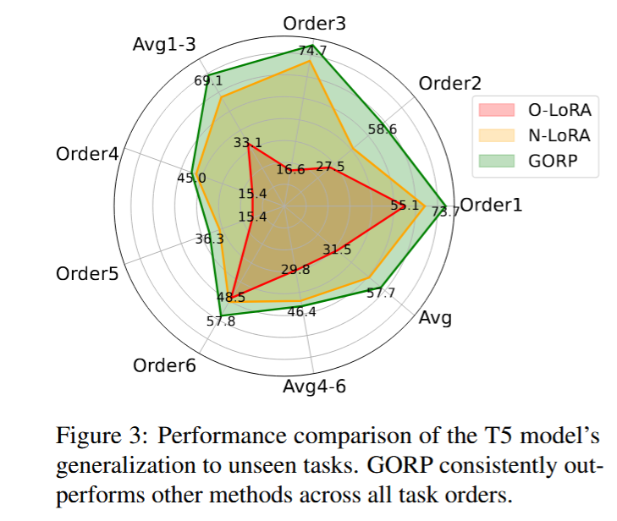
ATAI
Advanced Technique of Artificial Intelligence
ATAI
ChongqingUniversity _{AdvancedTechniqueof}
of Technology Artificial Intelligence
Chongqing University of
Technology
Chongqing University ^{ATAI}
_{of Technology} Advanced Techniqueof
Artificial Intelligence
Experiments
Chongqing University of Technology
Chongqing University of Technology

Slide 9
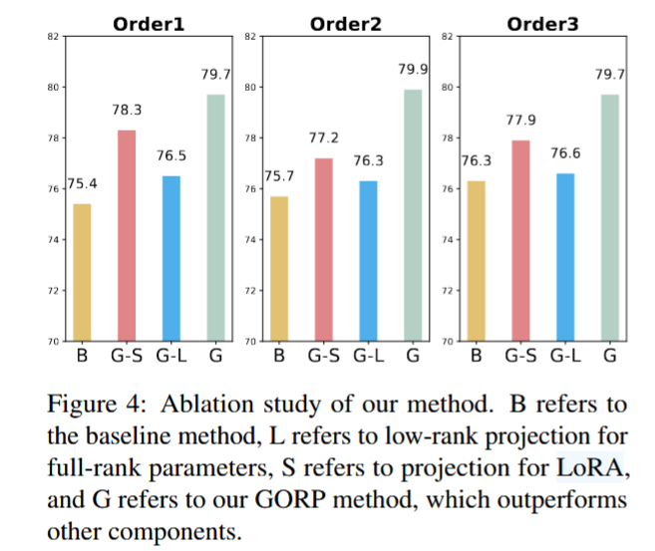
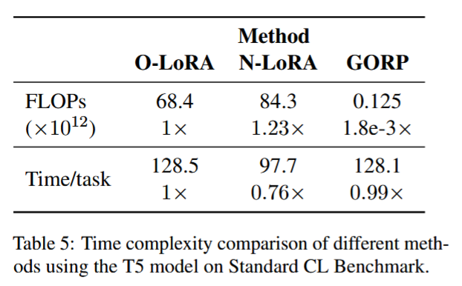
ATAI
Advanced Technique of Artificial Intelligence
ATAI
ChongqingUniversity _{AdvancedTechniqueof}
of Technology Artificial Intelligence
Chongqing University of
Technology
Chongqing University ^{ATAI}
_{of Technology} Advanced Techniqueof
Artificial Intelligence
Experiments
Chongqing University of Technology
Chongqing University of Technology

Slide 10
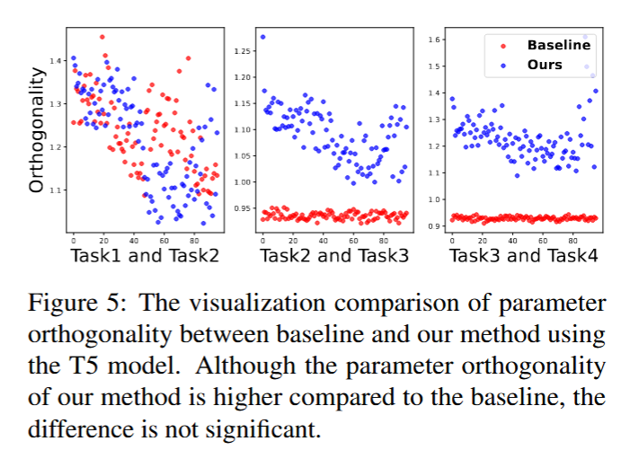
ATAI
Advanced Technique of Artificial Intelligence
ATAI
ChongqingUniversity _{AdvancedTechniqueof}
of Technology Artificial Intelligence
Chongqing University of
Technology
Chongqing University ^{ATAI}
_{of Technology} Advanced Techniqueof
Artificial Intelligence
Experiments
Chongqing University of Technology
Chongqing University of Technology

Slide 11
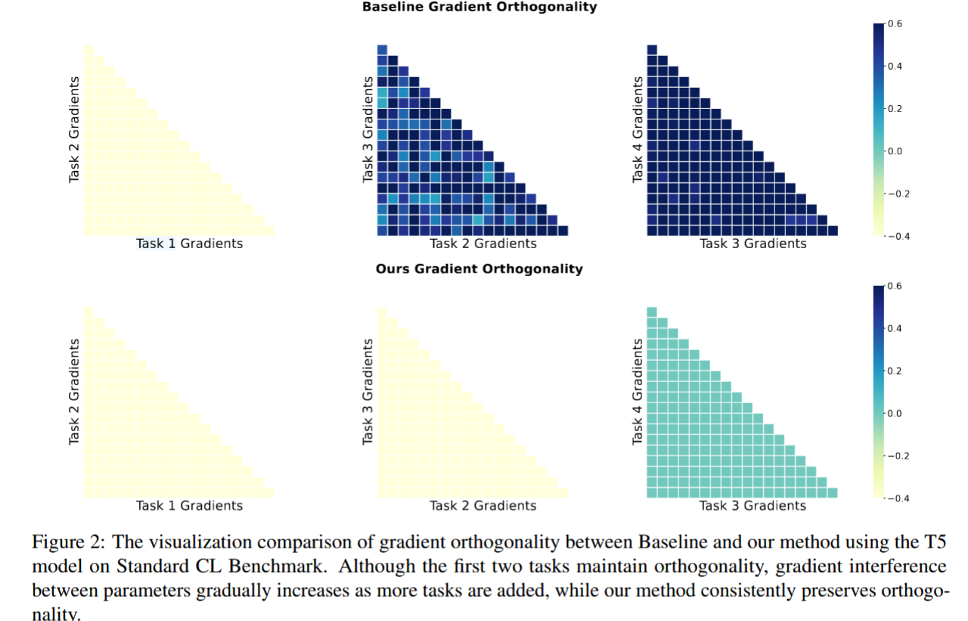
ATAI
Advanced Technique of Artificial Intelligence
ATAI
ChongqingUniversity _{AdvancedTechniqueof}
of Technology Artificial Intelligence
Chongqing University of
Technology
Chongqing University ^{ATAI}
_{of Technology} Advanced Techniqueof
Artificial Intelligence
Experiments
Chongqing University of Technology
Chongqing University of Technology

Slide 12


ATAI
Advanced Technique of Artificial Intelligence
ATAI
ChongqingUniversity _{AdvancedTechniqueof}
of Technology Artificial Intelligence
Chongqing University of
Technology
Chongqing University ^{ATAI}
_{of Technology} Advanced Techniqueof
Artificial Intelligence
Chongqing University of Technology
Chongqing University of Technology
Thanks!

